Slide 1

Data Bootcamp Final Project Presentation
Who Lives Longer Developed VS Developing Countries?
What are the Factors to Life Expectancy?

Slide 2


Who is Faisa?
A Londoner
An Optometrist
A Travel enthusiast
Why Data & Project Management
Interested in Health -Tech
Introduced to Analysis mindset at school.
Notes:
….I am excited about graduating from the Data Analytics boot camp.

Slide 3
My Project - Objectives
Questions I aim to answer with this project.
Who has a longer life expectancy? Developed or Developing?
Impact of measles on Infant death rates?
Who has a higher Adult mortality rate between developed and developing countries?
Effects of HIV, BMI and Alcohol on life expectancy? What countries is HIV more prevalent in?

Slide 4
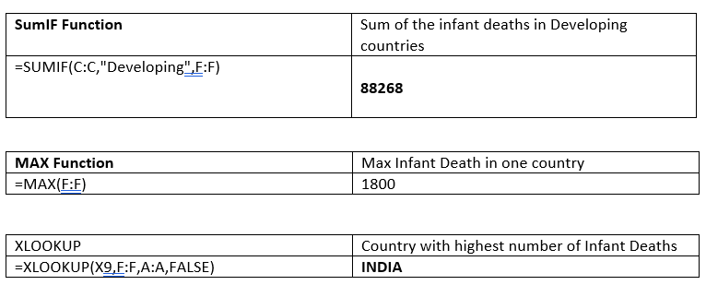
My Project - Excel Findings

Slide 5
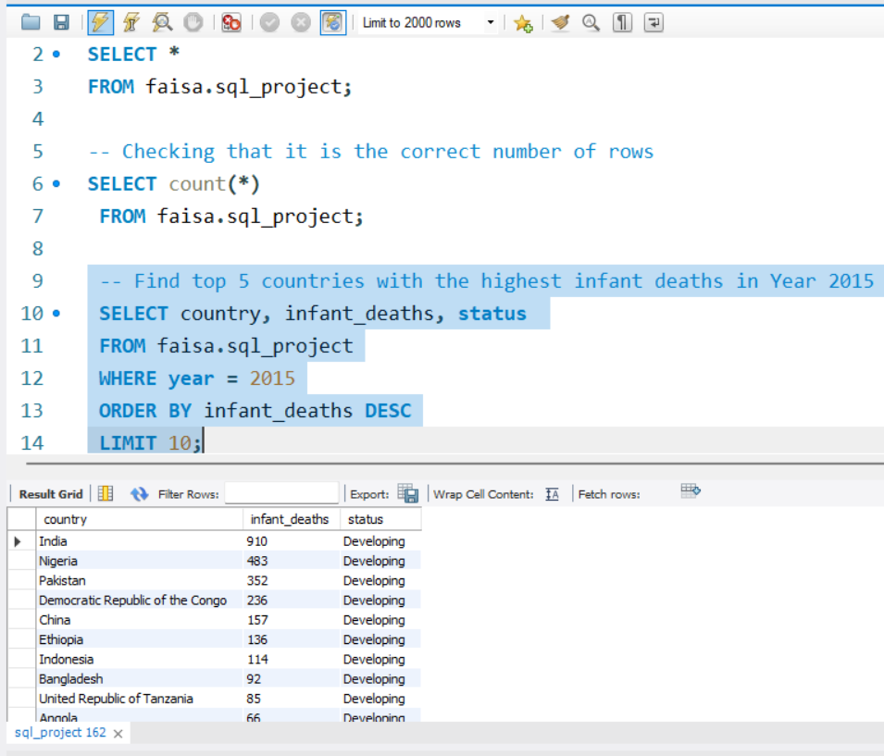
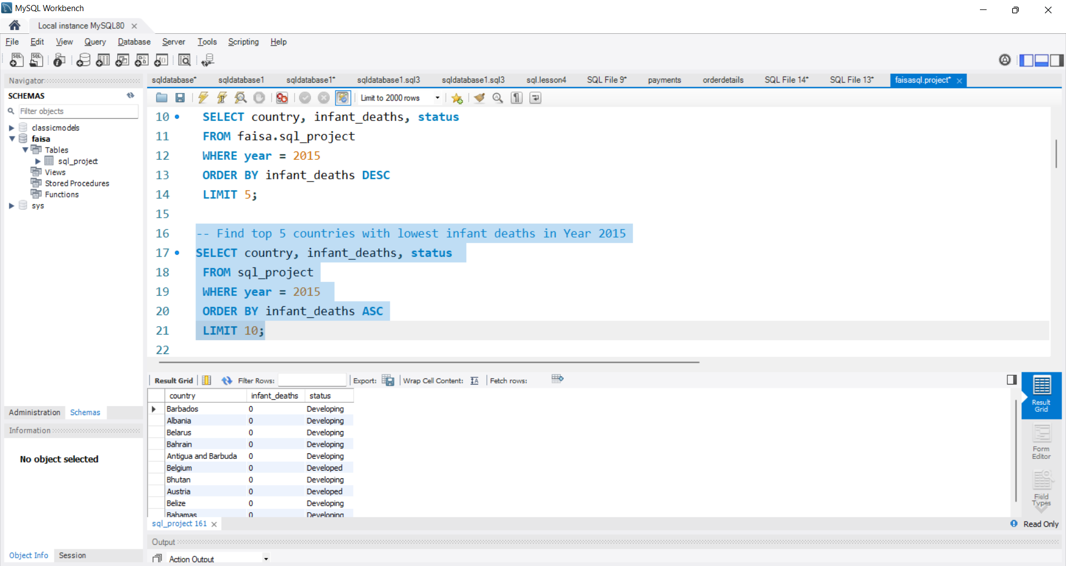
My Project - SQL Analysis
Infant Deaths Levels: Developed VS Developing Countries
?

Slide 6
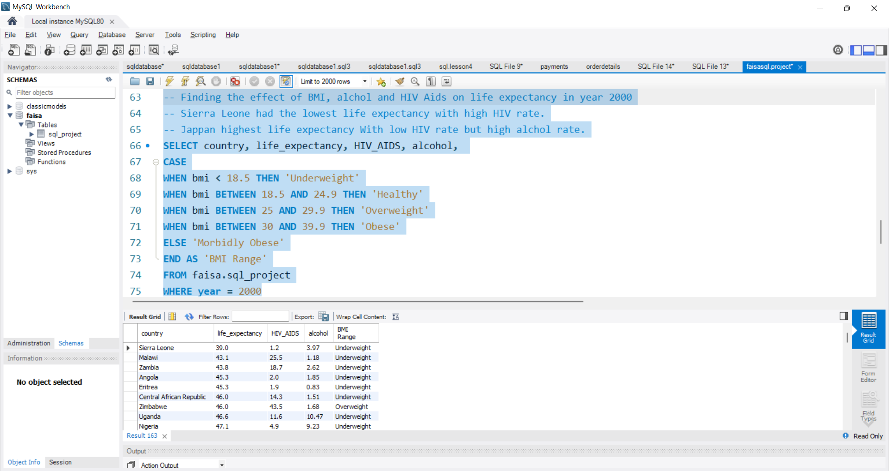
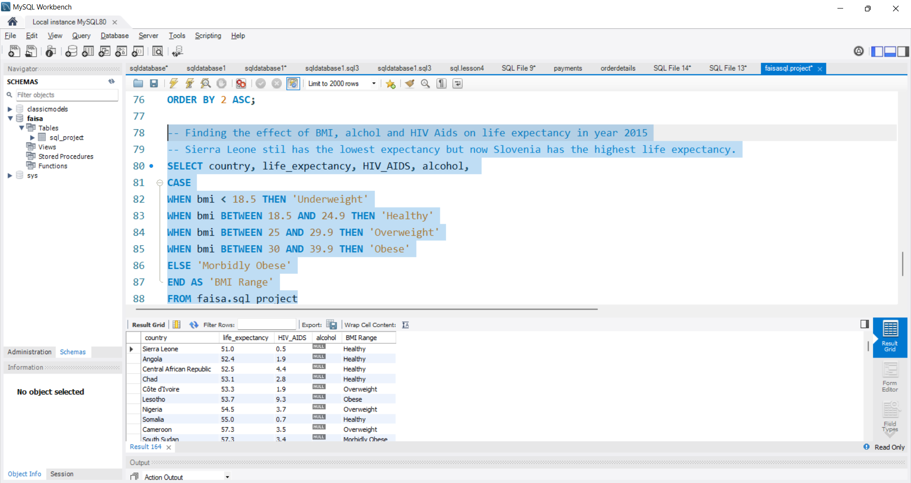
My Project - SQL Analysis
Effects of BMI, alcohol & HIV AIDS on Life Expectancy 2000 VS 2015

Slide 7
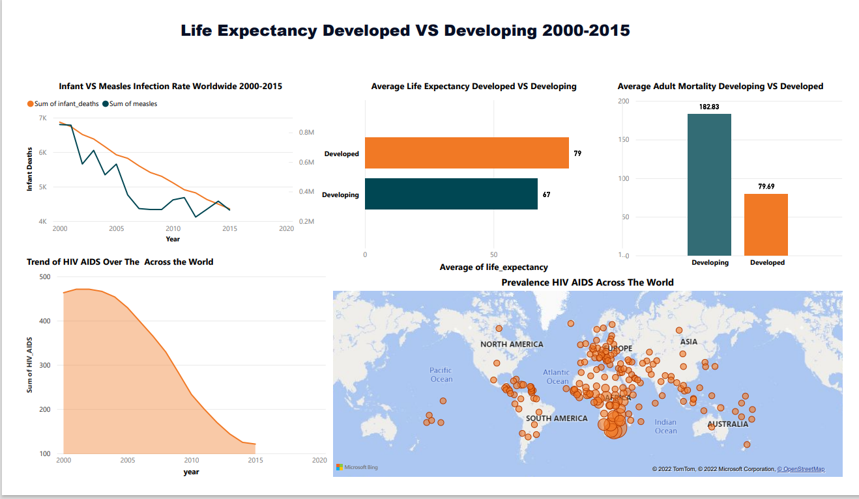
- Dashboard

Slide 8



My Project - Recommendations/Insights
The analysis shows the gap between developed and developing countries in regards to life expectancy is becoming smaller.
Which is a good sign, although the developed countries still had higher life expectancy in average.
Countries with high measles infection rates did have higher infant deaths. However there was a steady drop of infant death and measles infection rate across the years.
Developing countries had higher average adult mortality rate.
HIV and AIDS was more prevalent in African countries, although the general trend shows that the incident of it is falling across the years.

Slide 9
Challenges
I found that the some of the data did not make sense! E.g. when it showed some countries not having any infant deaths in a whole year?!
Realised that was probably because I did not clean the data ( rookie mistake I know!)
I would clean the data if I had more time.

Slide 10
Conclusion and Key Learnings
My Future Plans
I want to work within Product management and help create products/services that help people in the health services and for that you need to make decisions based on data.
Top 3 key learnings I am still capable of learning new academic knowledge Ability to connect and be outgoing within a large group of people. Career-wise. I learnt that I have transferrable skills and just picked up valuable practical skills for a successful career in Tech.
Key Skills I learnt on the Bootcamp project management principles data SQL , Tableau , Power BI and Python.

